Slide 1
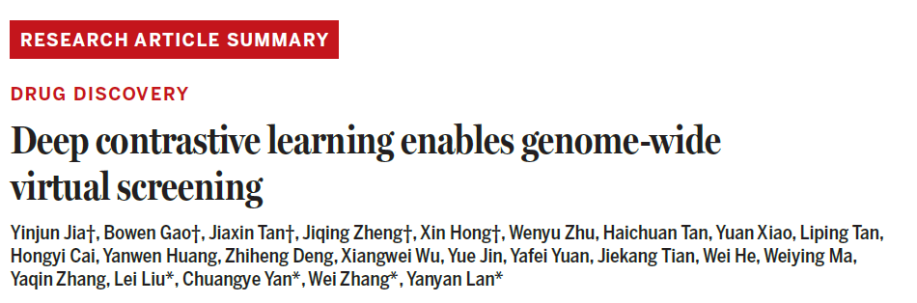
Deep Contrastive Learning Enables Genome-Wide Virtual Screening
Science 2026
Journal Club • Wendao Liu • 4/17/2026
Topics: Virtual Screening • Contrastive Learning • Drug Discovery • AlphaFold
Notes:
Welcome everyone. Today we're discussing a paper from the Yanyan Lan group at Tsinghua University, published in Science in January 2026. The paper introduces DrugCLIP, a contrastive learning framework that enables virtual screening at a scale previously thought impossible — screening half a billion compounds against 10,000 human proteins in a single day.

Slide 2
Section 1
Context & Motivation
Why genome-wide virtual screening matters — and why it's hard

Slide 3
The Drug Discovery Crisis
• ~90% of druggable disease targets still lack any approved small-molecule therapy
• Traditional drug discovery: 10–15 years, $1–2 billion per approved drug
• Hit identification (finding a starting molecule) is the first major bottleneck
• High-throughput screening (HTS) is expensive, and limited to ~10M compounds
• Virtual screening (VS) offers a computational shortcut: rank molecules before synthesis
• But current VS methods are far too slow for genome-scale applications
Notes:
Open with the scale of the problem. Despite decades of investment, the vast majority of the human druggable genome remains unexplored therapeutically. The bottleneck we care about today is hit identification — finding any molecule that binds to a target well enough to be a starting point.

Slide 4
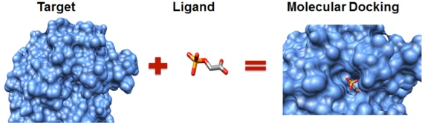
Virtual Screening: Promise vs. Reality
• Core idea: computationally dock/score millions of molecules against a protein pocket
• Classic docking pipeline: place molecule → score interactions → rank → test top hits
• State-of-the-art tools: Glide, AutoDock Vina, Uni-Dock
Based on molecular docking
• Problem 1 — Speed: Glide needs ~3 days for 100K compounds × 1 target (16 CPUs)
• Problem 2 — Scale: Genome-wide = 10K targets × 500M molecules → O(M × N) cost
• Problem 3 — Accuracy on AF2: docking accuracy degrades on predicted structures
• Deep learning models (PLANET, PFAM) are faster but still require per-pair inference
Notes:
Walk through what virtual screening actually involves. The key computational insight that motivates DrugCLIP is the O(M×N) scaling problem — you need to evaluate every molecule against every target. DrugCLIP converts this into an O(M+N) search problem.

Slide 5
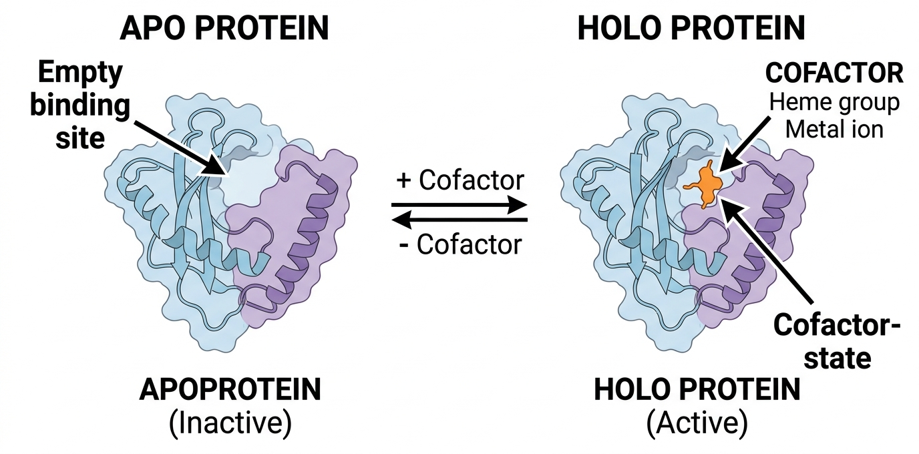
The AlphaFold Revolution
• AlphaFold2 (2021) predicted structures for >200 million proteins with high accuracy
• RoseTTAFold All-Atom extended this to nucleic acids, ligands, and complexes
• Human proteome: ~20,000 protein-coding genes, structures now available for ~10,000
• Opportunity: structure-based drug discovery for ALL druggable targets, including dark proteome
• Challenge 1: AF2 predicts 'apo' (unbound) conformations — pocket geometry is imprecise
apo: protein structure without ligand
holo: protein structure with ligand
• Challenge 2: sidechain conformations in binding pockets are often inaccurate
• Challenge 3: docking to AF2 structures underperforms experimental structures by ~30–40%
Notes:
AlphaFold is the enabling technology that makes this paper possible and timely. Without accurate structure prediction, you can't do structure-based VS at genome scale. But AF2 structures are not a drop-in replacement for crystal structures — the pockets need refinement.

Slide 6
The Central Question
• Can we screen 500 million compounds against 10,000 proteins in a short time with high accuracy?
• Scale: 5 × 10¹² protein–ligand pairs
• Traditional docking: would take ~decades
• Even fast ML docking: ~years at this scale
• Key insight: we don't need to score each pair individually
• We need a shared embedding space where similarity = binding
• Desired properties of a solution:
– Encode each molecule once, not per-target
– Encode each pocket once, not per-molecule
– Retrieval via cosine similarity (O(M+N))
• This is exactly what CLIP does for images & text…
Notes:
This slide motivates the conceptual leap. The trick is recognizing that screening is fundamentally a retrieval problem, not a regression problem. Once you frame it that way, CLIP-style contrastive learning is the natural solution.

Slide 7
Section 2
Methods Overview
CLIP inspiration · DrugCLIP architecture · GenPack · Screening pipeline

Slide 8
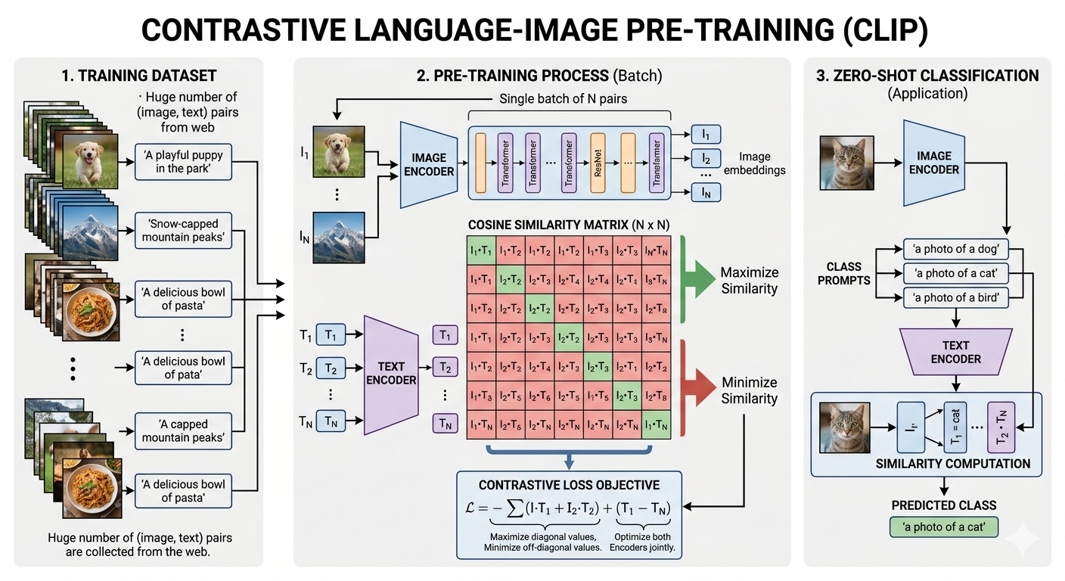
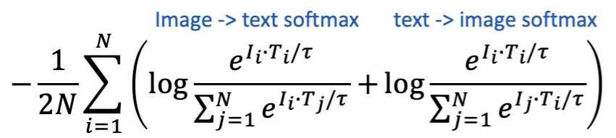
CLIP: The Inspiration
Radford et al., OpenAI 2021 • Contrastive Language–Image Pre-training
• Goal: learn aligned representations of images and text from 400M web (image, caption) pairs
• Architecture: two encoders — one for images (ViT/ResNet), one for text (Transformer)
• Training: contrastive loss — pull matched pairs together, push mismatched pairs apart in embedding space
• Inference: encode query image once; retrieve matching text by cosine similarity — no re-scoring
• Key insight: any two modalities that co-occur can be aligned in a shared latent space
Notes:
CLIP was a landmark paper that showed you could learn powerful joint representations purely from naturally paired data — no labels, no task-specific supervision. The core trick is contrastive learning over large batches. Once embeddings are learned, retrieval is a simple dot product. DrugCLIP directly ports this idea to structural biology.

Slide 9
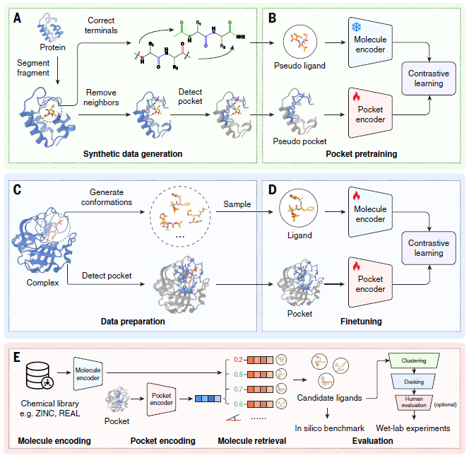
DrugCLIP: The Core Idea
• Direct CLIP analogy:
– Image → Protein pocket (3D)
– Text → Small molecule (3D)
– Caption–image pairs → protein–ligand pairs
• Training: Pretraining: synthetic/pseudo protein-ligand generated from PDB
Finetuning: experimentally validated protein-ligand complex structure from BioLip2
• Positive pair: known binder. Negative pairs: all others in batch
• Loss pushes known binders close; decoys far apart
Screening = cosine similarity search (milliseconds)
• O(M+N) replaces O(M×N)
• 10 million× faster than docking
Notes:
This slide makes the analogy explicit and quantifies the speedup. The key conceptual shift is from 'score each pair' to 'find nearest neighbors in embedding space'. Once embeddings are pre-computed, the actual screening step is trivially fast.

Slide 10



Architecture: Dual Encoder
• Both encoders use Uni-Mol architecture — a transformer that takes 3D atomic coordinates as input
• Pocket Encoder:
– Input: protein fragments around binding site (residues within 10 Å of ligand)
– Outputs a fixed-size pocket embedding vector
• Molecule Encoder:
– Input: 3D conformer of small molecule
– Outputs a fixed-size molecular embedding vector (same size as pocket embedding vector)
• Contrastive loss: InfoNCE + bidirectional (ligand→pocket and pocket→ligand)
Notes:
The architecture choices are pragmatic — both encoders reuse strong pre-trained 3D molecular representations. The key design choice is the symmetry: you can query in either direction (given a pocket, find molecules; or given a molecule, find pockets). The 3D input is crucial — 1D SMILES or fingerprints would lose the binding-site shape information.

Slide 11
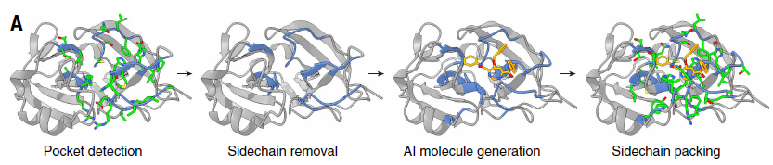
GenPack: Fixing AlphaFold Pockets
• Problem: AF2 apo structures have poorly defined binding pockets
• Sidechain positions inaccurate → wrong pocket shape → degraded screening performance
• Previous fix: IFD-MD (induced-fit docking + MD) — accurate but extremely slow (~days/pocket)
• GenPack approach:
– 1. Detect initial pocket using Fpocket (geometric pocket finder)
– 2. Remove sidechain atoms from pocket residues
– 3. Run AI-generative model conditioned on backbone → sample realistic sidechains
– 4. Pack new sidechains and refine with physics-based force field
• Outcome: Better binding pockets
Notes:
GenPack is a clever solution to a real problem. The core issue is that AF2 sidechains in predicted pockets are often in unrealistic conformations because they weren't optimized in the context of a ligand. GenPack re-samples them generatively to create pockets that look more like holo (ligand-bound) conformations.

Slide 12
End-to-End Screening Pipeline
• Step 1 — Pocket Detection: Fpocket detects binding sites; GenPack refines AF2 sidechain conformations
• Step 2 — Pre-encoding (done once):
– Encode all protein pockets → pocket embedding database
– Encode all 500M molecules → molecule embedding database (stored)
• Step 3 — Screening (milliseconds per target):
– Cosine similarity search: top-N molecules for each pocket
– DrugCLIP-S: sequential (38 s for 100K molecules); DrugCLIP-P: parallel GPU (23 ms)
– Resources: https://drugclip.com
• Step 4 — Post-processing: optional re-ranking with docking or affinity prediction (Boltz-2, AuroBind)
• Step 5 — Validation: surface plasmon resonance (SPR) binding assays, enzyme assays, cryo-EM for top hits
Notes:
Walk through the pipeline end-to-end. Emphasize that the molecule database only needs to be encoded once — that amortizes the cost across all targets. The re-ranking step (Step 4) can optionally use physics-based docking or affinity models to improve hit quality, but is not required.

Slide 13
Section 3
Benchmarks & Speed
DUD-E · LIT-PCBA · Generalization · Speed comparison

Slide 14
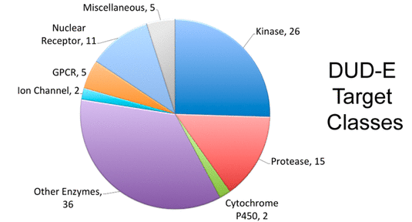
Benchmark Datasets
• DUD-E (Directory of Useful Decoys Enhanced)
– 102 protein targets
– 22,886 active compounds
– 50× decoys per active (structurally similar but not binding)
– Standard benchmark for screening
• LIT-PCBA (realistic HTS benchmark)
– 15 targets from real PubChem BioAssay HTS data
– ~1.4M tested compounds per target — true negatives
– Much harder and more realistic than DUD-E
• Metric: EF1% (Enrichment Factor at 1%)
– How many-fold more actives are in the top 1% than by random?
– EF1% = 1 means no better than random; higher is better
Mysinger et al. J Med Chem 2012
Nguyen et al. J Chem Inf Model 2020
Notes:
These two benchmarks test different aspects. DUD-E has a known weakness — decoys can be separated from actives by physicochemical properties alone, inflating scores. LIT-PCBA is harder and considered more realistic. DrugCLIP outperforms baselines on both.

Slide 15
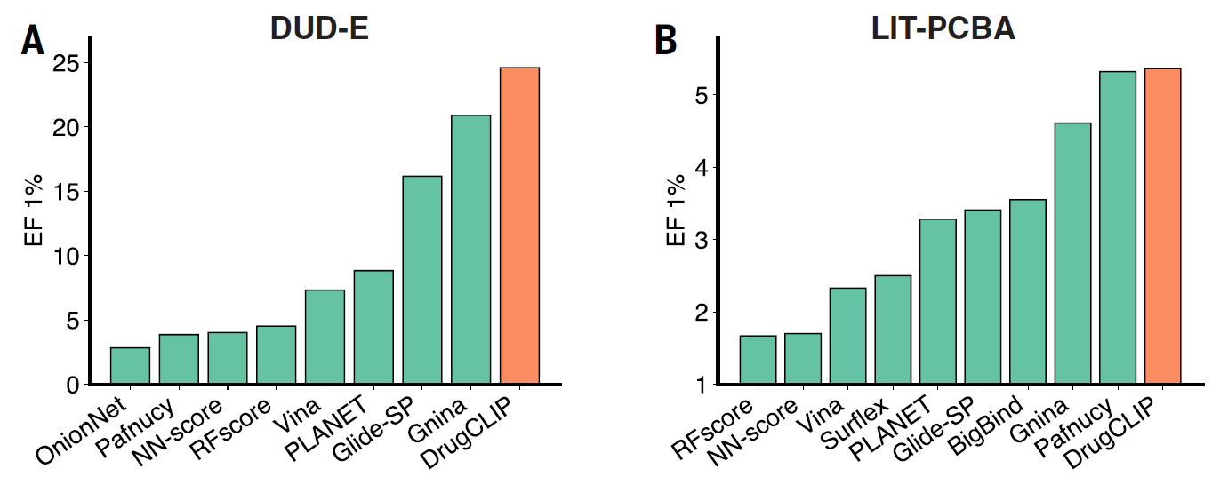
Benchmark Results
EF1% bar chart: DrugCLIP vs. all baselines
EF1%: fold better than random
DrugCLIP achieves highest median EF1% on DUD-E, outperforming Glide-SP, Vina, PLANET, PFAM, and deep-learning baselines.
Notes:
DrugCLIP outperforms all methods on DUD-E EF1%. Key comparisons: vs Glide-SP (best traditional docking) and vs PLANET (best prior ML method). Also note that DUD-E performance is high across the board — the harder LIT-PCBA benchmark is more discriminating.

Slide 16
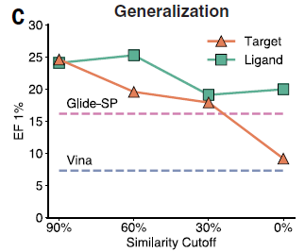
Generalization
generalization at 30/60/90% similarity cutoffs
Molecular similarity between training and testing set
DrugCLIP maintains performance as training/test similarity drops
Notes:
LIT-PCBA is the more important benchmark because it uses real HTS data. The generalization plot (Fig. 2C) is crucial for real-world use: it shows DrugCLIP works even for targets with no close homologs in training data, which is exactly the scenario for the dark proteome.

Slide 17
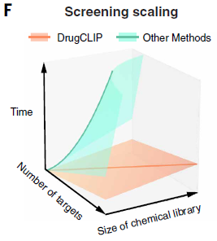
Speed: From Days to Milliseconds
• Time to screen 100K compounds against 1 target (A100 GPU or stated hardware):
– Glide-SP: ~3 days (128 CPU cores)
– Uni-Dock: ~22 hours (A100 GPU)
– PLANET: ~3 hours (A100 GPU)
– DrugCLIP-S: 38 s (A100 GPU)
– DrugCLIP-P: 23 ms (A100 GPU, parallel)
• Scaling advantage: O(M+N) vs O(M×N)
– Docking: must re-run for every (target, molecule) pair
– DrugCLIP: encode once, search always — cost grows linearly, not multiplicatively
• Genome-wide screen (10K × 500M): ~1 day on 8× A100 GPUs
Notes:
The speed numbers are striking. DrugCLIP-P is ~5,000× faster than PLANET and ~10 million× faster than Glide for a single target. But the scaling advantage compounds: for N targets, the speedup grows proportionally with N, because pocket encodings are reused. This is what makes genome-scale screening feasible.

Slide 18
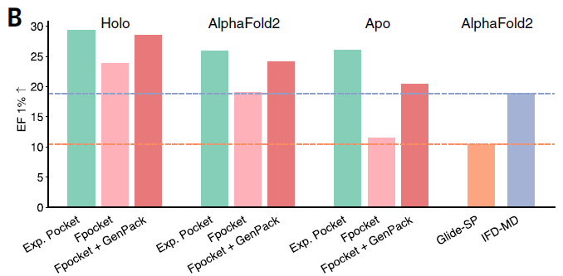
GenPack: Improving pocket structure
• Enhancing the screening power of AlphaFold2-predicted structures by increasing the EF1% value
Notes:
The speed numbers are striking. DrugCLIP-P is ~5,000× faster than PLANET and ~10 million× faster than Glide for a single target. But the scaling advantage compounds: for N targets, the speedup grows proportionally with N, because pocket encodings are reused. This is what makes genome-scale screening feasible.

Slide 19
Section 4
Wet-Lab Validation
5-HT₂A · NET (cryo-EM) · TRIP12 (unexplored target)

Slide 20
Experimental Validation Strategy
• DrugCLIP output: ranked molecule lists for each target
• Hit selection: top-ranked compounds not known as binders; filtered by drug-likeness (MW, QED)
• Compound sourcing: ChemDiv and TargetMol commercial libraries (~100 compounds per target)
• Primary assay: radio-ligand transport assay (for transporters) or calcium flux / FLIPR (for GPCRs)
• Confirmation: SPR (surface plasmon resonance) for binding affinity (K_{d})
• Structural validation: cryo-EM for NET inhibitor binding pose
• Enzyme assays for TRIP12 (E3 ubiquitin ligase activity)
• Three targets studied: 5-HT₂A receptor, NET (norepinephrine transporter), TRIP12
Notes:
The experimental pipeline is rigorous. Note that they did not just rely on predicted docking poses — they confirmed binding biophysically by SPR and structurally by cryo-EM. The 17.5% hit rate for TRIP12 (a target with NO prior binders) is particularly impressive.

Slide 21
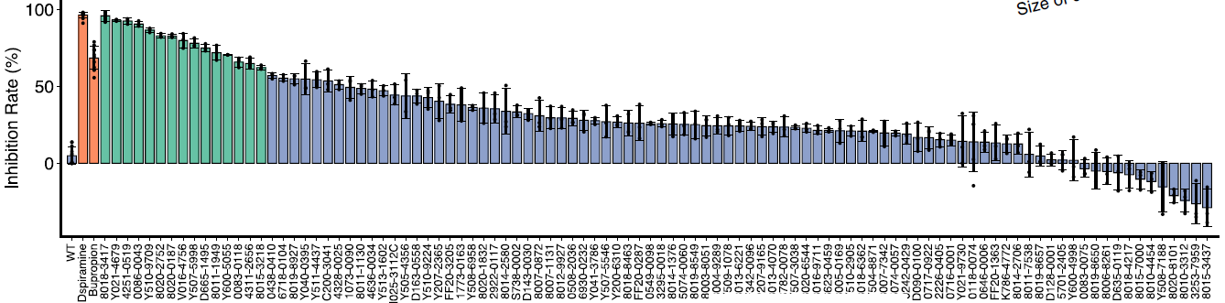
Validation: NET
• Target: NET— for depression, ADHD
• Screened ChemDiv library using DrugCLIP with experimental NET crystal structure
• Tested 100 top-ranked compounds in calcium flux assay (FLIPR) at 10 µM
• Result: 15 compounds showed ≥60% inhibition / agonist activity
• Two agonists with IC₅₀ < 1.5 μM (bupropion):
– Both validated in follow-up multicycle SPR assays (K_{d} confirmed)
– Structurally validated with cryo-EM (binding pose confirmed)
Notes:
5-HT2A is a well-validated psychiatric drug target. Finding sub-100 nM agonists from a computational screen alone (without iterative medicinal chemistry) is a strong result. The cryo-EM confirmation is particularly valuable as it rules out non-specific or allosteric binding.

Slide 22
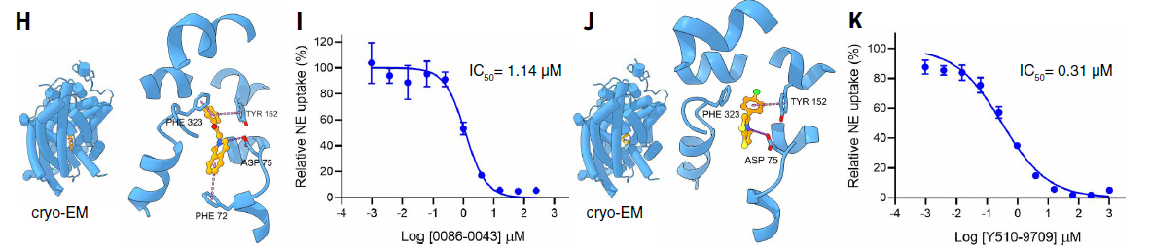
Validation: NET Inhibitors Confirmed by Cryo-EM
SPR binding curve + cryo-EM density map of 0086-0043 in NET pocket
Compound 0086-0043: K_{d} = 1.14 µM by SPR; IC₅₀ = 0.31 µM. Cryo-EM structure (3.3 Å) confirms binding pose in NET. 5 of 15 screened NET inhibitors showed >60% inhibition.
Notes:
NET is the target of SNRIs (serotonin-norepinephrine reuptake inhibitors), one of the most widely prescribed classes of antidepressants. Getting a cryo-EM structure is major — it proves the hit binds exactly where predicted, validating the DrugCLIP embedding space for capturing true binding-site complementarity. IC50 of 310 nM is good for a first-pass computational screen.

Slide 23
TRIP12: An Unexplored Drug Target
• TRIP12: Thyroid hormone Receptor Interacting Protein 12
• Function: E3 ubiquitin ligase — regulates protein ubiquitination and degradation
• Biological roles:
– Regulates tumor suppressor stability → overexpressed in multiple cancers
– Controls UBE4 ubiquitination → linked to neurodegenerative disease
– Inhibits BRCA1 → DNA repair; linked to cancer cell survival
• Drug discovery status: NO reported small-molecule binders or inhibitors
• No holo crystal structure; no ligand; starting from AF2 prediction only
• This makes TRIP12 an ideal test case for DrugCLIP + GenPack on the dark proteome
Notes:
TRIP12 is the paper's most impressive case study because it represents the real challenge of the dark proteome — a target with clear disease relevance but no prior chemical matter and no experimental structure. If DrugCLIP can find hits for TRIP12, it validates the whole genome-wide vision.

Slide 24
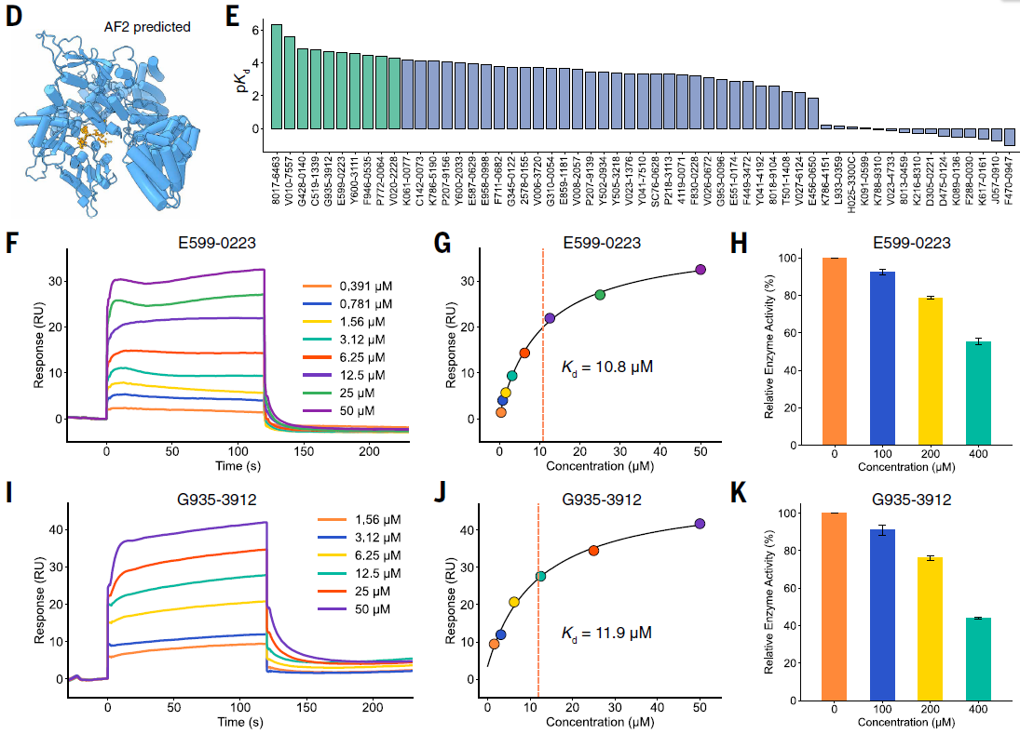
TRIP12: Inhibitor Discovery Results
Measurement of binding
E599-0223: K_{d} = 10.8 µM, IC₅₀ confirmed by enzyme assay. G935-3912: K_{d} = 11.9 µM. 17.5% hit rate (7/40 compounds) in SPR — remarkable for a target with zero prior binders.
Notes:
The 17.5% hit rate is exceptional for a primary screen, especially for a completely unexplored target. For context, typical HTS hit rates are 0.01–0.1%. Even accounting for lower potency (µM range), these are validated starting points for medicinal chemistry. The fact that GenPack was essential here (without it, no hits were found) validates its role in the pipeline.

Slide 25
Section 5
Genome-Wide Screen
10,000 proteins · 500M compounds · GenomeScreenDB

Slide 26
The Genome-Wide Campaign
• Scale: ~10,000 AlphaFold2-predicted human proteins × 500 million compounds
• Hardware: 8× NVIDIA A100 GPUs
• Runtime: completed in ~1 day
• Equivalent docking time estimate: tens of thousands of years
• Output: >2 million candidate molecules across >20,000 pockets
• Proteins selected: all human proteins with at least one detectable pocket in AF2 structure
• Compound library: 500M drug-like molecules
• Post-processing: top-100 molecules per pocket → stored in GenomeScreenDB database
Notes:
Put the scale in perspective. 10,000 × 500M = 5 trillion potential interactions. At 1 second per docking pose, that's 160,000 years. DrugCLIP does it in 24 hours. This is not just an incremental speedup — it's a qualitative change in what's possible in drug discovery.

Slide 27
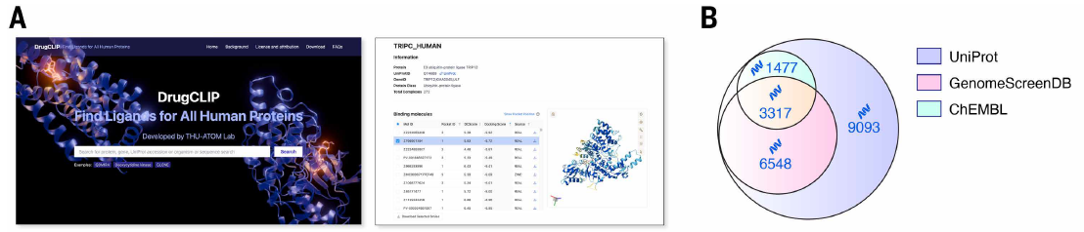
GenomeScreenDB: An Open-Access Resource
website screenshot of drugclip.com; Venn diagram vs ChEMBL and UniProt
GenomeScreenDB covers ~9,025 human protein targets with predicted hit molecules — 3× more than ChEMBL (~3,000 targets with known binders). Freely accessible at https://drugclip.com.
Notes:
This is a genuine community resource. ChEMBL, which took decades to build through real experimental work, covers roughly 3,000 human targets. GenomeScreenDB covers 9,000+ in a single computational campaign. Of course the quality differs — these are predicted, not validated hits — but they provide starting points for any target.

Slide 28
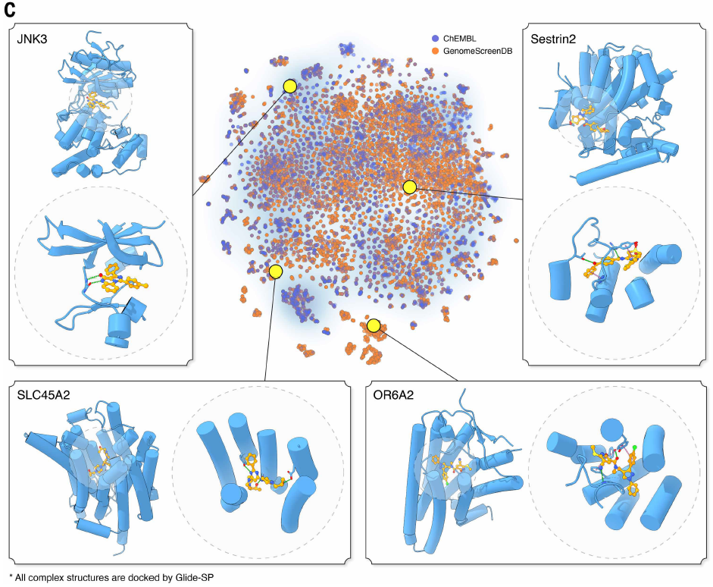
Case Studies from the Genome-Wide Screen
• JNK3 (MAP kinase, anticancer target) — predicted hits overlap known inhibitor scaffolds
• Sestrin2 (mTORC1 regulator, metabolic disease) — novel chemotypes identified
• SLC45A2 (melanocyte transporter, cancer immunotherapy) — no prior binders; predicted molecules show drug-like properties
• OR6A2 (olfactory receptor, expressed in colon cancer) — GPCRs are historically undrugged; DrugCLIP provides first computational hits
• targets cluster by protein family; molecule hits cluster by predicted binding
Notes:
These case studies span a range of target families — kinases, transporters, GPCRs, metabolic regulators — showing the method is not specialized to one protein class. OR6A2 is particularly interesting: olfactory receptors are one of the largest gene families but almost completely undrugged.

Slide 29
Opportunity: The Undrugged Genome
• ~6,000 of 10,000 screened human proteins have NO entries in ChEMBL (a manually curated database of bioactive molecules with drug-like properties)
• For these 'dark proteome' targets, DrugCLIP provides the first computational starting points
• Database freely available — enables any lab to retrieve hits for their target of interest
• Integration potential:
– Boltz-2 / AuroBind: re-score DrugCLIP hits with structure-affinity co-prediction
– Affinity prediction models: prioritize candidates for synthesis
– Standard drug discovery workflow: DrugCLIP → medchem optimization → preclinical validation
• Foundation for the 'post-AlphaFold era' of drug discovery
Notes:
This is the broader vision. AlphaFold democratized structural biology; DrugCLIP aims to democratize hit identification. Together, they lower the bar for starting a drug discovery program on any target — even targets that would previously require years of biochemical tool development before you could even begin screening.

Slide 30
Section 6
Discussion & Conclusions
Limitations · Impact · Discussion questions

Slide 31
Limitations & Open Questions
• Potency: most wet-lab validated hits are µM binders (not nM)
• Contrastive learning ≠ binding affinity: DrugCLIP ranks, not predicts ΔG
• No ADMET: hits not filtered for solubility, permeability, metabolic stability
• No selectivity assessment: off-target activity not evaluated
• Pocket dependency: GenPack still requires an identifiable pocket — cryptic sites challenging
• AlphaFold conformational variability not captured: single structure used per target
• DUD-E bias: decoy design may inflate benchmark numbers (known issue in the field)
• Validation breadth: only 3 targets experimentally tested vs. 10K screened
Notes:
Be honest about the limitations in journal club. The µM potency issue is real but not unusual for a primary screen — medicinal chemistry optimization is expected. The more fundamental limitation is the binary nature of the training signal: contrastive learning treats binding as a yes/no, not a quantitative affinity. Future directions could incorporate affinity-weighted contrastive loss.

Slide 32
Impact & Broader Significance
• Democratizes hit identification: any lab can query GenomeScreenDB for their target
• Enables dark proteome exploration: 6,000+ targets with zero prior chemical starting points now accessible
• Synergy with emerging tools:
– AlphaFold3 / Boltz-2 / RoseTTAFold for better pocket structures
– AuroBind / structure–affinity coprediction for post-screen prioritization
– Generative chemistry (RFdiffusion) for target-specific library design
• Beyond small molecules: same framework applicable to peptide–protein or RNA–ligand screening
• Foundation for a new era: AlphaFold gave us structures; DrugCLIP gives us molecules
• Inspiration of other models: CLIP can be used for mutual alignment/prediction other any multimodal biomedical data
Notes:
Close on the big picture. The paper's contribution is not just a faster docking method — it's a new paradigm for how we approach drug discovery at scale. The combination of near-unlimited structural data (AlphaFold) and near-unlimited chemical space search (DrugCLIP) fundamentally changes what's feasible for any target.

Slide 33
Summary
1. DrugCLIP encodes protein pockets & molecules into a shared latent space via contrastive learning, enabling genome-wide virtual screening 10M× faster than docking.
2. Wet-lab experiments confirm potent hits for 5-HT₂A, NET (cryo-EM validated), and TRIP12 (the first reported binders for this unexplored E3 ligase).
3. GenomeScreenDB — 9,000+ human protein targets with predicted hits — is freely available as a foundation resource for the post-AlphaFold drug discovery era.
Discussion / Q&A
Paper DOI: 10.1126/science.ads9530 Database: https://drugclip.com
Notes:
Close with these three takeaways and open for discussion. Suggested discussion questions: (1) How does EF1% compare to what's needed in practice for a successful drug discovery campaign? (2) What would it take to go from the TRIP12 µM hits to a clinical candidate? (3) What additional data or training signals could improve DrugCLIP's affinity predictions?

